Slide 1
Web Traffic Analysis
Data Analyst | June 2025

Slide 2
Project Overview
Objective: Analyze web traffic data to derive actionable insights.
Data Source: Kaggle dataset
Tools: Python (Pandas, Seaborn, SkLearn), PowerPoint

Slide 3
Traffic Source Insights
Organic traffic generally leads to higher conversion rates.
Paid and Social traffic show more variability in performance.
Refer to boxplot: Conversion Rate by Traffic Source.

Slide 4
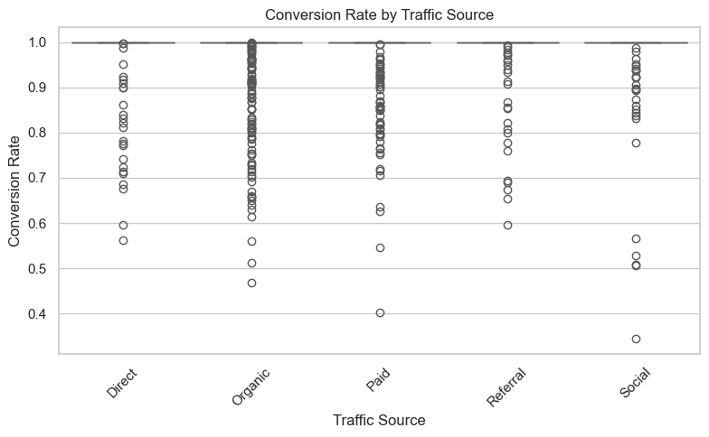
Conversion Rate by Traffic Source

Slide 5
Behavioral Insights
Lower bounce rates correlate with higher conversion rates.
Time on Page and Previous Visits are positively related to conversions.
Refer to scatterplot and correlation heatmap for details.

Slide 6
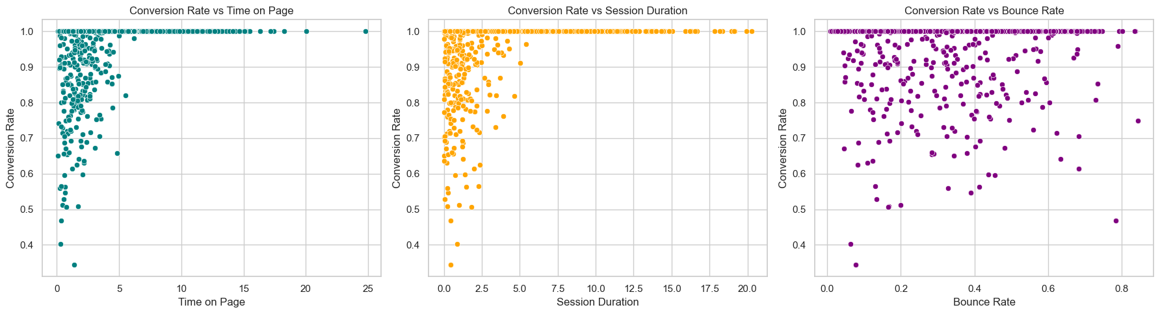
Conversion Rate vs Key Metrics

Slide 7
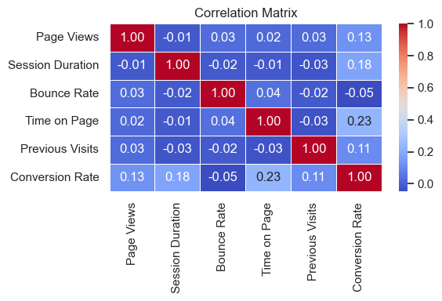
Correlation Heatmap

Slide 8
Predictive Modeling
Model Used: Random Forest Regressor
Target: Conversion Rate
Features: Page Views, Session Duration, etc.
Key Influencers: Time on Page, Previous Visits, Bounce Rate

Slide 9
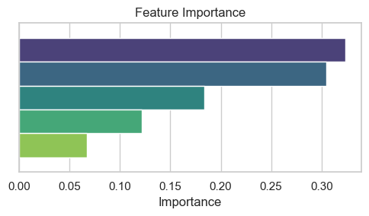
Conversion prediction modelling

Slide 10
Recommendations
Focus on organic traffic acquisition for better conversion.
Improve landing page UX to reduce bounce rate.
Segment returning visitors for tailored engagement strategies.
Enhance long-session experiences with personalized content.

Slide 11
Conclusion
Web traffic analysis provides critical user behavior insights.
Deploy dashboards for real-time tracking.
A/B test homepage and high-traffic pages to refine strategies.

